Slide 1
CVE Project by Kiat Boon and Jaryl

Slide 2
4Ws Problem Canvas
The self-driving car may not know what are all the traffic signs , where they are ,how to prepare for a stop before reaching the stop sign. It also may not know what a U-turn sign is like what does it look like, and might not know when to prepare for a U-turn. This brings danger for onboard passengers.

Slide 3
🚗 4Ws Problem Canvas part 1: Self-Driving Cars
1. Who
Primary stakeholders:
  Urban commuters
  Elderly and disabled individuals (mobility support)
  Logistics and delivery companies
  Governments and city planners
  Car manufacturers and tech companies
Secondary stakeholders:
Pedestrians and cyclists (safety concerns) Insurance companies Traffic enforcement agencies
2. What
The problem:
  Human driving errors cause accidents, congestion, and inefficiency.
  Limited accessibility for people who cannot drive.
  High costs of logistics due to reliance on human drivers.
Challenges in self-driving cars:
Handling unpredictable human behavior on roads.
Navigating complex urban environments.
Ensuring cybersecurity and preventing hacking.
Legal and ethical responsibility in case of accidents.

Slide 4
4Ws problem canvas part 2:
3. Where:
Geographic scope:
Urban cities with heavy traffic (e.g., Singapore, New York, Tokyo).
Highways for long-distance logistics.
Suburban and rural areas with less infrastructure (harder adoption).
Situational scope:
Daily commuting
Freight and delivery services
Ride-hailing and public transport integration
4. Why
Importance of solving the problem:
Reduce road accidents (90% caused by human error).
Increase mobility access for non-drivers.
Lower transportation costs and improve efficiency.
Support sustainability by optimizing routes and reducing emissions.
Enable smart city integration with autonomous fleets.
📊 Summary Table

Slide 5
Computer Vision Applications
AI50031FP
4W Problem Canvas (Who, What, Where, Why)

Slide 6
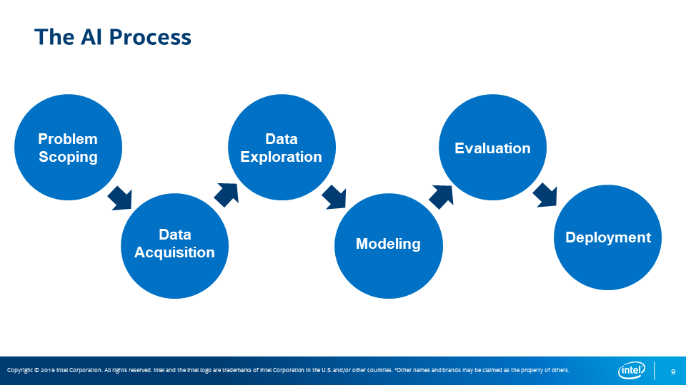

Slide 7
Situation
Self driving car cannot recognise the traffic signs like stop and u turn as well as the speed limit.

Slide 8
Situation part 1
Here’s a clear snapshot of the current situation with self-driving cars:
🚗 Current State of Self-Driving Cars
Progress Achieved
Autonomous vehicles can reliably follow lanes, maintain safe distances, and navigate familiar routes.
They’ve accumulated millions of miles in testing, performing well on highways and controlled urban zones.
Key Challenges
Edge cases: Rare but dangerous scenarios like sharp bends on wet roads, construction zones with missing lane markings, or intersections with improvised hand signals still confuse systems.
Human interaction: Mixed control between driver and automation can lead to unpredictable outcomes.
Global Deployment Outlook
Governments (like the US and UK) are pushing policies to accelerate rollout.
Robotaxis and autonomous trucks are being tested, but widespread adoption is expected to unfold gradually over the next decade.
Future Vision
Analysts see autonomous vehicles reshaping urban planning, commuting, and even consumer trust.
By 2040, they could significantly alter city infrastructure and daily life.
⚠️ Risks & Limitations
Current AI systems excel at object detection and mapping but struggle with reasoning in unpredictable, human-driven environments.
More data alone won’t solve these issues; deeper improvements in AI reasoning and adaptability are needed.
🌍 Big Picture
Self-driving cars are no longer science fiction—they’re already on roads in limited contexts. But the leap from controlled tests to fully autonomous everyday driving is slowed by safety, trust, and regulatory hurdles. The trajectory is clear: autonomy is coming, but cautiously.

Slide 9
4Ws Problem Canvas
Who is having the problem?
1. Who are the stakeholders?
Self-driving cars (autonomous vehicles) involve a wide network of stakeholders because they affect technology, transportation, law, insurance, urban planning, and everyday consumers. Here’s a structured breakdown of the key stakeholders:
🚗 1. Automotive Manufacturers
Traditional car companies developing autonomous vehicles, such as:
Tesla
Toyota
Ford Motor Company
General Motors
Interest: Innovation leadership, market share, safety reputation, regulatory compliance, profitability.
💻 2. Technology Companies
Firms developing AI, sensors, mapping, and software systems:
Waymo
Apple
NVIDIA
Intel
Copyright © 2019 Intel Corporation. All rights reserved. Intel and the Intel logo are trademarks of Intel Corporation in the U.S. and/or other countries. *Other names and brands may be claimed as the property of others.

Slide 10
I
Who are the stakeholders part 2
Interest: innovation, data collection, hardware/software sales, platform dominance.
🏛 3. Governments & Regulators
National and local agencies responsible for safety, infrastructure, and public policy:
National Highway Traffic Safety Administration
European Commission
Interest: Public safety, traffic regulation, legal frameworks, infrastructure planning, economic competitiveness.
👥 4. Consumers (Drivers & Passengers)
Individuals who purchase or use autonomous vehicles.
Interest: Safety, convenience, affordability, privacy, reliability.
🚚 5. Transportation & Logistics Companies
Ride-sharing, delivery, and freight companies:
Uber
Lyft
FedEx
Interest: Reduced labor costs, efficiency, fleet automation, competitive advantage.
🛡 6. Insurance Companies
Auto insurers who must redefine liability models.
Interest: Risk assessment, accident liability (driver vs. manufacturer), new insurance products.
👷 7. Professional Drivers
Taxi drivers, truck drivers, delivery drivers, bus drivers.
Interest: Job security, retraining opportunities, wage impact.
🏙 8. Urban Planners & Local Communities
City governments, infrastructure planners, and residents.

Slide 11
Who are the stakeholders part 3 interest: Traffic flow, reduced congestion, parking needs, environmental impact, road design changes.
⚖ 9. Legal System & Law Enforcement
Courts, lawyers, and police departments.
Interest: Determining liability in accidents, updating traffic laws, enforcement procedures.
🌍 10. Society at Large
Pedestrians, cyclists, and the broader public.
Interest: Safety, ethical AI decisions, environmental impact, data privacy.
Summary
Self-driving cars are not just a technological innovation — they represent a systemic shift affecting economic, legal, social, and ethical systems. Stakeholders range from global corporations to everyday pedestrians.

Slide 12
2. What do you know about them?

Slide 13
What do you know about them part 1
Here’s a deeper look at the stakeholders of self-driving cars—what they care about, what they gain or risk, and how they influence the industry.
🚗 1. Automotive Manufacturers
Examples: Tesla, Toyota, General Motors
What they want:
Competitive advantage in next-generation vehicles
New revenue streams (software subscriptions, data services)
Brand leadership in safety and innovation
What’s at stake:
High R&D costs
Product liability risks
Regulatory compliance
They are transitioning from traditional car manufacturing to software-driven mobility platforms.
💻 2. Technology Companies
Examples: Waymo, Apple, NVIDIA
What they want:
AI dominance and data collection
Platform ecosystems (maps, cloud, chips)
Expansion into mobility services
What’s at stake:
Data privacy concerns
Safety reputation
Massive capital investment returns
They often supply the brains (AI software) and hardware powering autonomous systems.

Slide 14
What do you know about them part 2
🏛 3. Governments & Regulators
Example: National Highway Traffic Safety Administration
What they want:
Public safety
Economic competitiveness
Clear liability frameworks
What’s at stake:
Balancing innovation with safety
Infrastructure investment costs
Public trust
They control testing approvals, road laws, and safety standards.
👥 4. Consumers (Drivers & Passengers)
What they want:
Safety and reliability
Convenience (less driving effort)
Affordable pricing
Concerns:
Trust in AI
Loss of control
Data privacy
Consumer acceptance will determine mass adoption.
🚚 5. Transportation & Logistics Companies
Examples: Uber, FedEx
What they want:

Slide 15
What do you know abt them part 3
Lower labor costs
24/7 operations
Fleet efficiency
Risks:
High transition costs
Public backlash if jobs are displaced
They see AVs as a way to dramatically reduce operational expenses.
🛡 6. Insurance Companies
What they want:
New risk models
Clear determination of fault
Shift happening:
Insurance may move from driver-based liability to product liability (manufacturer/software-based).
👷 7. Professional Drivers
Includes taxi, truck, delivery, and bus drivers.
What they want:
Job security
Retraining opportunities
Risk:
Job displacement in the long term
They are one of the most socially sensitive stakeholder groups.
🏙 8. Urban Planners & Local Communities
What they want:
Reduced congestion
Improved safety
Environmental benefits

Slide 16
What do you want to know abt them part 4
Potential impact:
Less need for parking
Redesign of city infrastructure
Possible increase in traffic if robotaxis are overused
⚖ 9. Legal & Judicial System
What they want:
Clear liability standards
Precedent for accident responsibility
They must adapt existing traffic and product laws to AI systems.
🌍 10. Society at Large (Pedestrians, Cyclists, Public)
What they want:
Safer streets
Ethical AI decision-making
Environmental responsibility
Public perception strongly influences regulation and adoption.
🔎 Big Insight
The key tension among stakeholders is:
Innovation vs. safety

Slide 17
What do you want to know abt them part 5
Efficiency vs. employment
Data use vs. privacy
Corporate control vs. public regulation
Self-driving cars are not just about technology — they are about economic power, social change, and ethical responsibility.

Slide 18
Context (Where)
Urban, highway, suburban deployment challenges
Infrastructure gaps and unpredictable environments
High variability in human-driven surroundings

Slide 19
How do we know it's a problem?
Real-world incidents reveal current technical limits in safety-critical contexts.
Regulation lags technology, creating ambiguity in standards and liability.
Stakeholders—industry, regulators, drivers, and consumers—have conflicting interests.
Economic and social stakes are high across jobs, insurance, and urban systems.
Sustained public debate and media attention signal unresolved societal concerns.
Bottom line: Evidence across safety, law, economics, and public trust shows this is a real, unresolved problem.

Slide 20
Problem Statement Template
Our | Stakeholders | Who
has/have a problem that | The self driving car cannot recognize the stop or u-turn sign and speed limit. | What
when / while | this results in delayed driving speed, not knowing when to u turn and when to stop as well as the speed limit | Where
An ideal solution would | be computer vision–based solution that enables higher accuracy that leads to higher success rates. | Why
Copyright © 2019 Intel Corporation. All rights reserved. Intel and the Intel logo are trademarks of Intel Corporation in the U.S. and/or other countries. *Other names and brands may be claimed as the property of others.

Slide 21
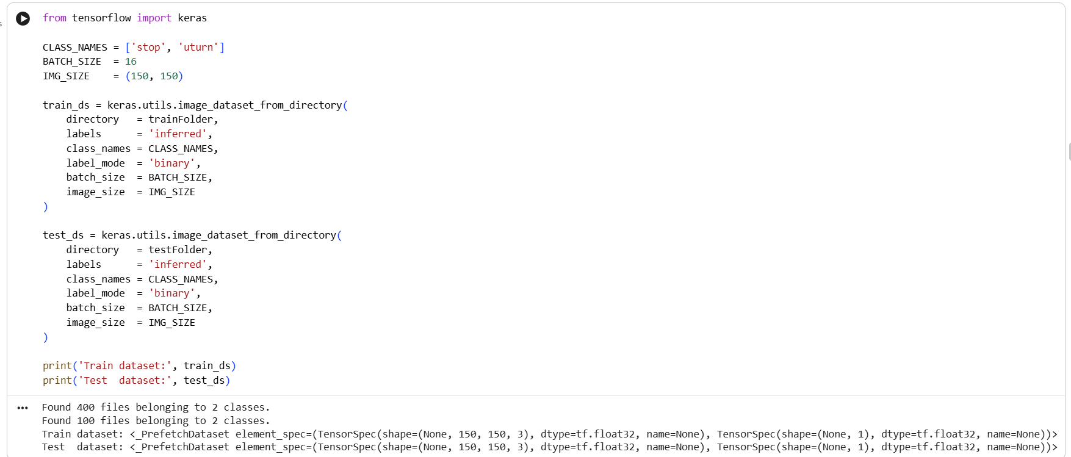
Build an image classifier

Slide 22
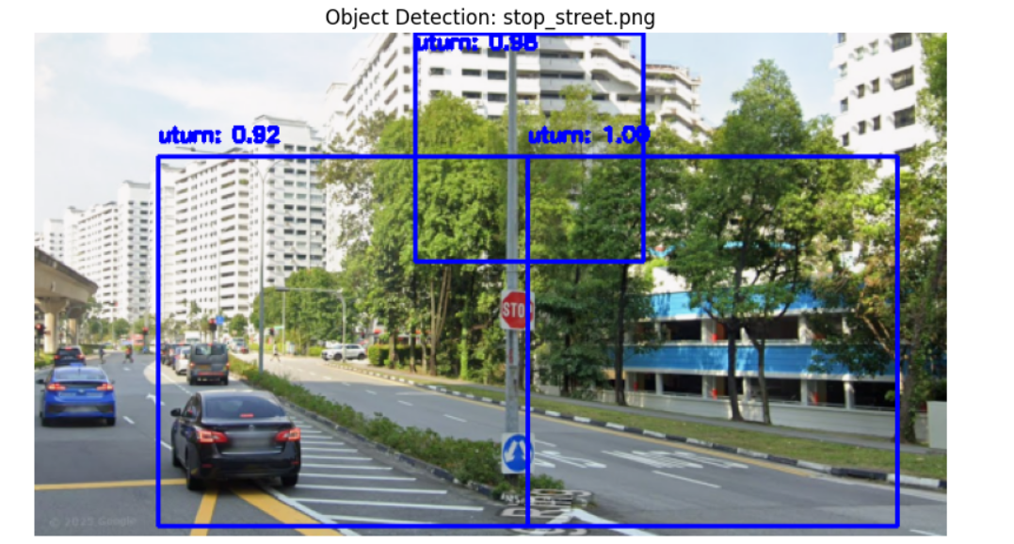
Object detection

Slide 23
Context (Where)
Urban, highway, suburban deployment challenges
Infrastructure gaps and unpredictable environments
High variability in human-driven surroundings

Slide 24
Stakeholder Value (Why)
Safety, cost reduction, accessibility
Regulatory clarity and public trust
Efficient logistics and smart-city alignment

Slide 25
Nature of the Problem (What)
High-stakes safety-critical decisions
Legal and ethical uncertainty
Public trust and job displacement concerns

